Slide 1

Rmit Project
tcw-Australia
15-05-2018

Slide 2
Index
1: Spaceplanning
2: Seat Types Summary
3: Lighting system
4: Signage
5: Donor plate specifications
15-05-2018

Slide 3
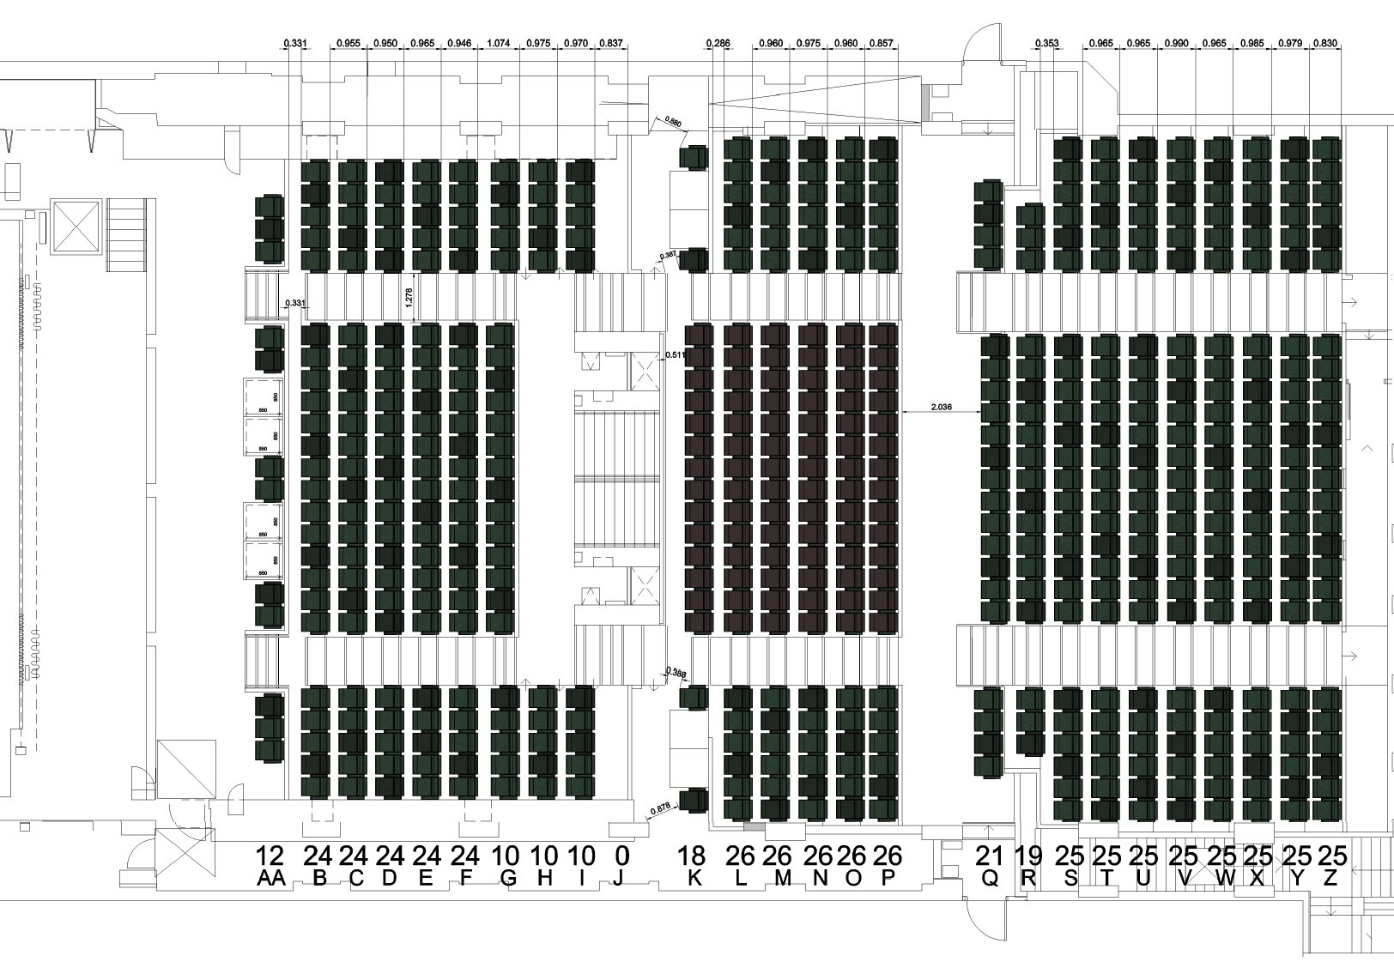
2d spaceplanning-REAL FINISHES TONE

Slide 4
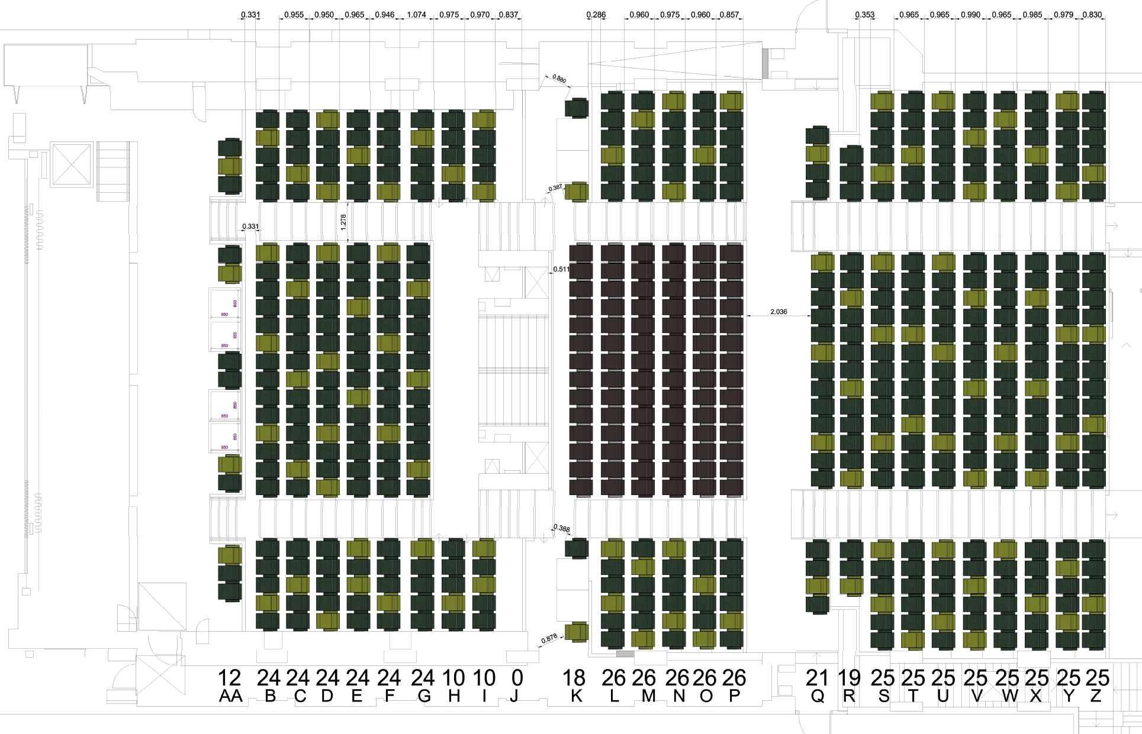
2d spaceplanning-ADAPTED FINISHES TO EASY COUNT BY TYPE

Slide 5
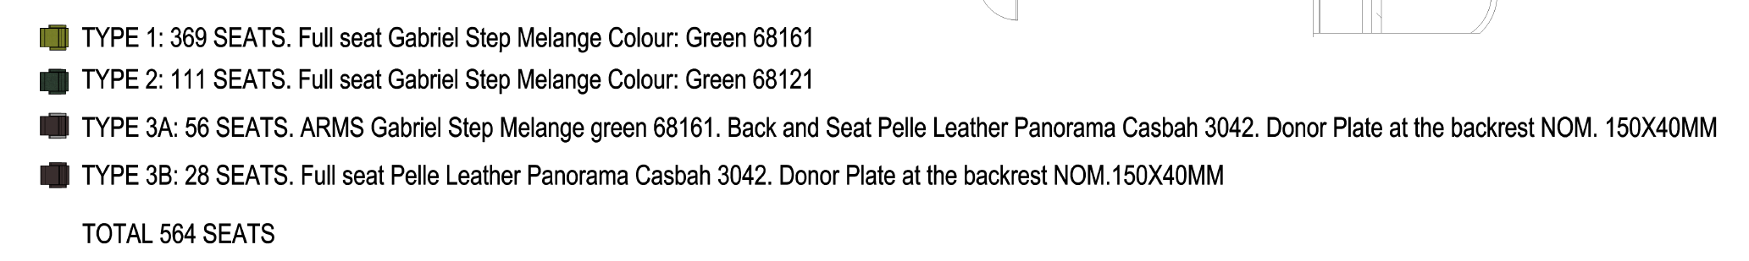
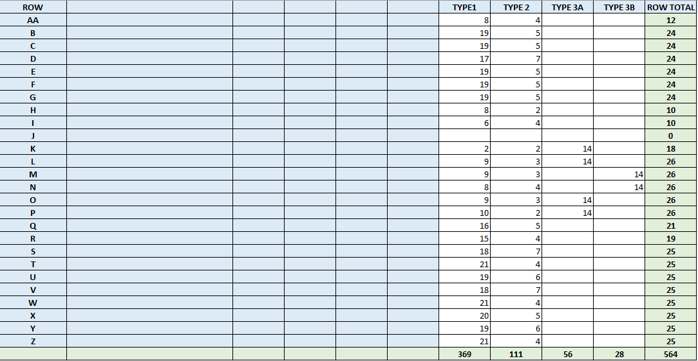
General seat types Summary

Slide 6
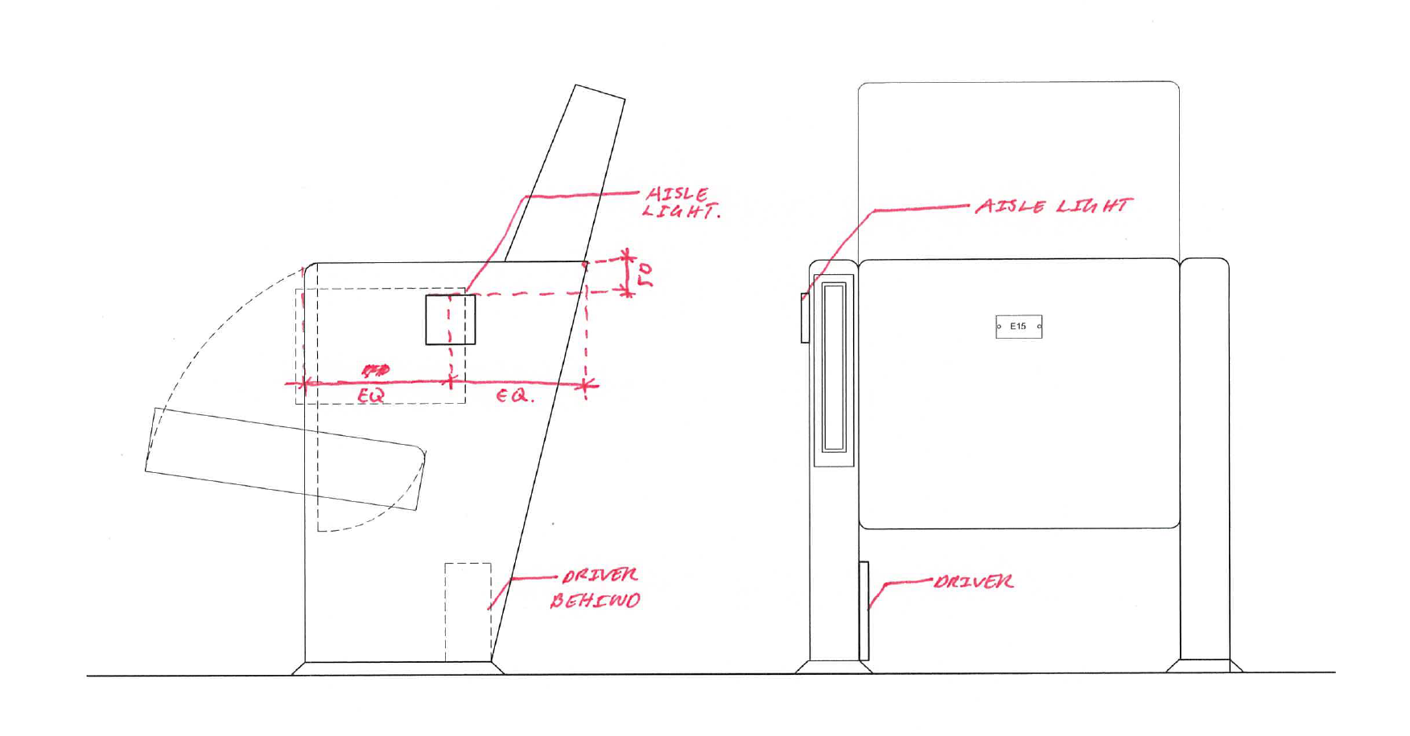
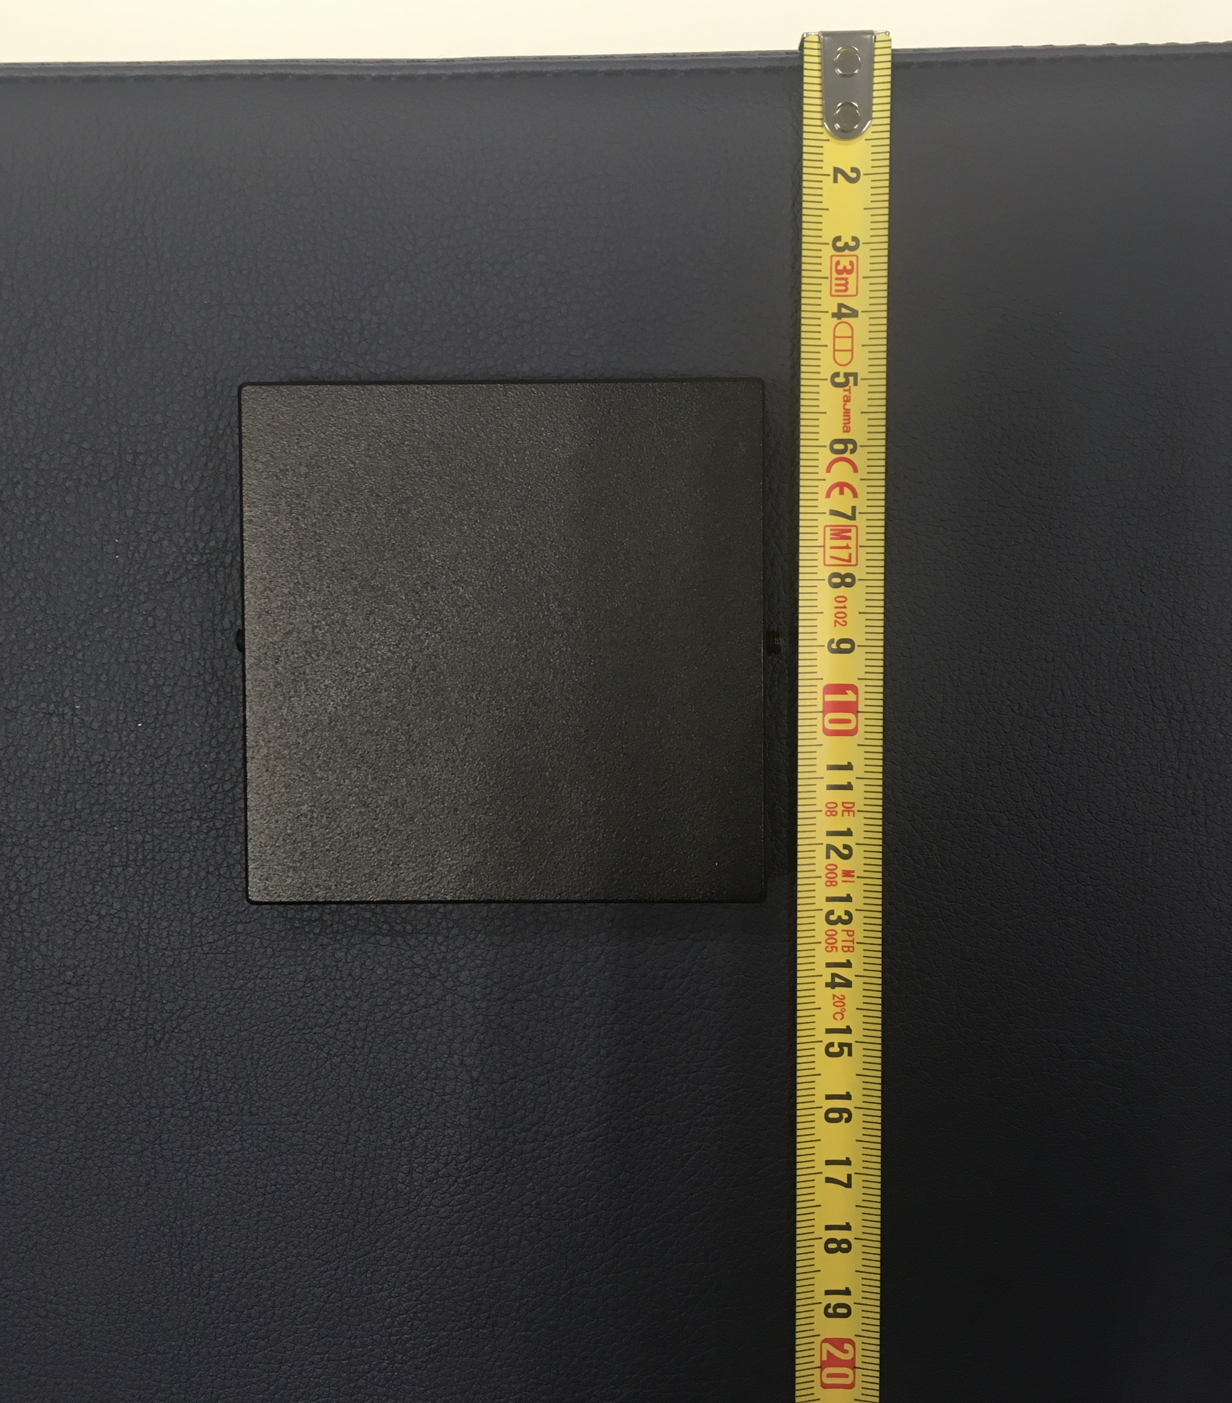
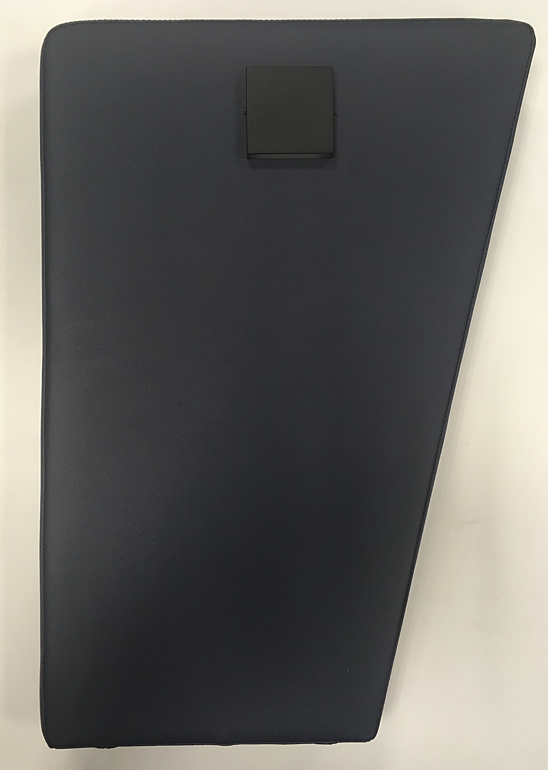
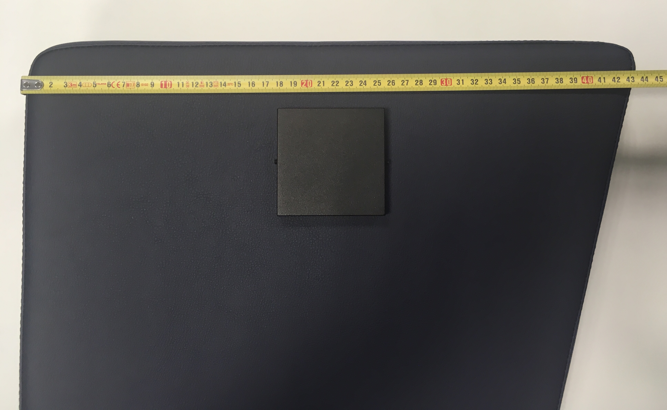
Lighting system
Prototype Measures

Slide 7
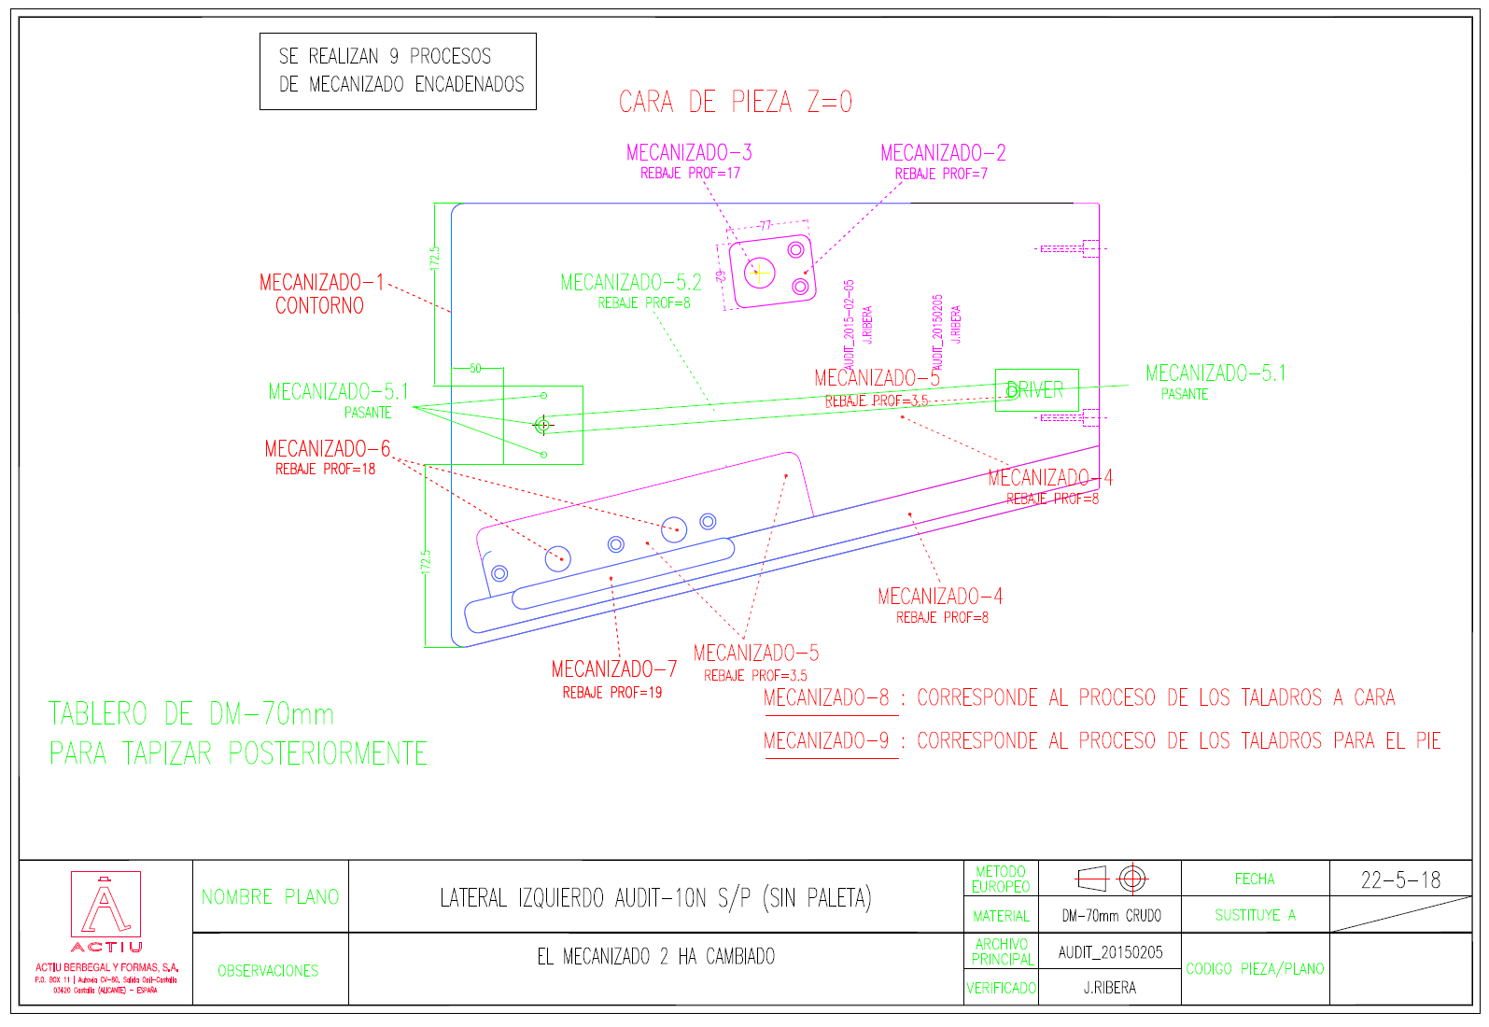
Lighting system
Prototype Drawing

Slide 8
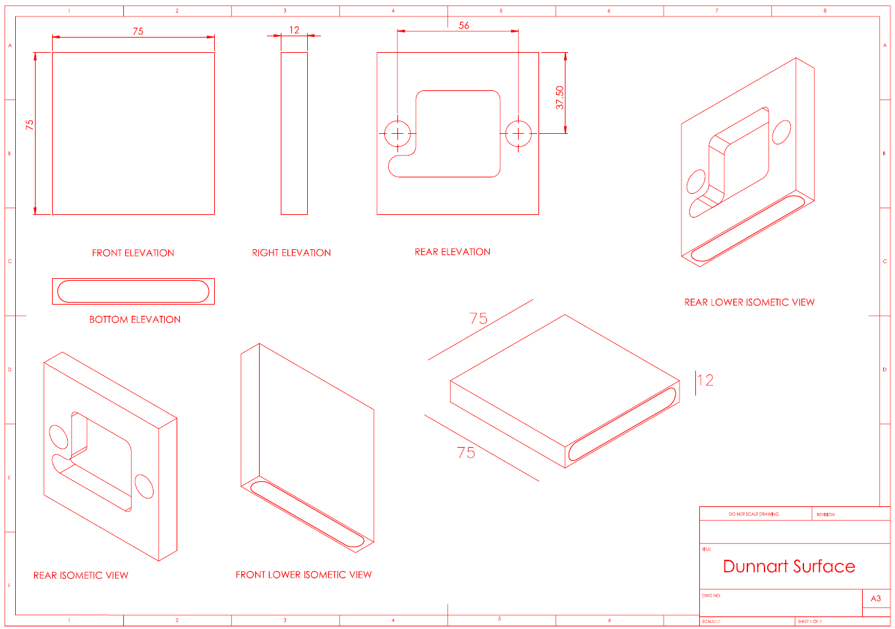
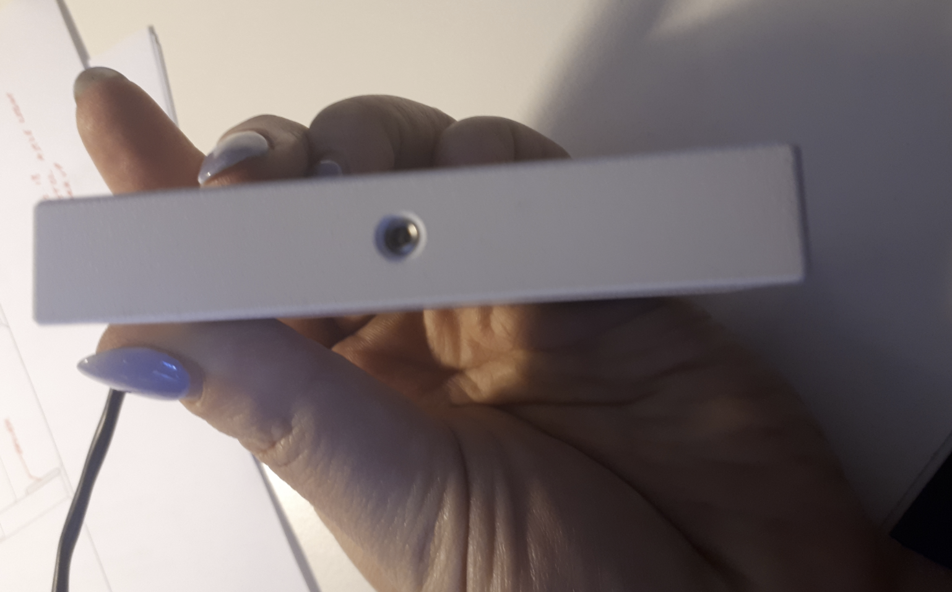
Lighting system
2: Driver:
If you send us a sample of the real driver, we can include it at the prototype of the customized Audit 10 lateral as you saw on the report for the Audit 20 (parliament Project). We could use the same light sample. Below picture was sent by TCW, but we do not have the driver phisically in hq.
picture sent by TCW

Slide 9
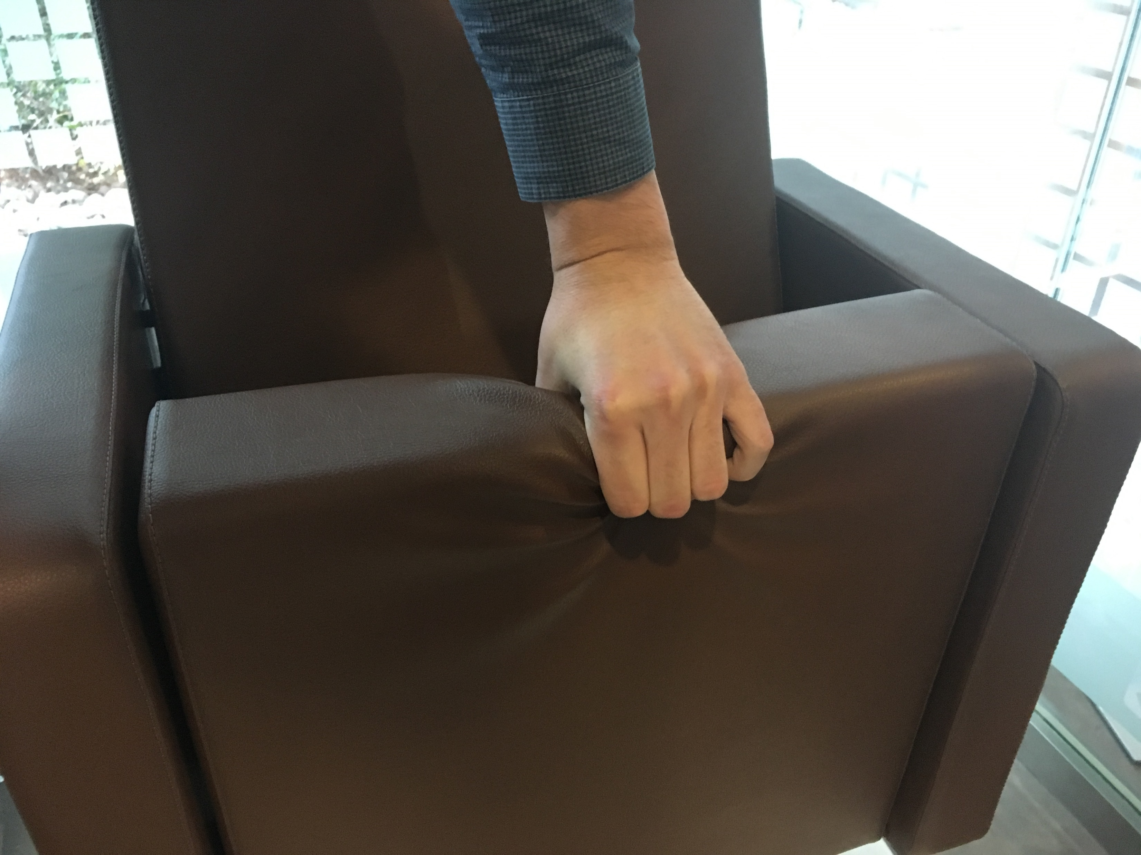
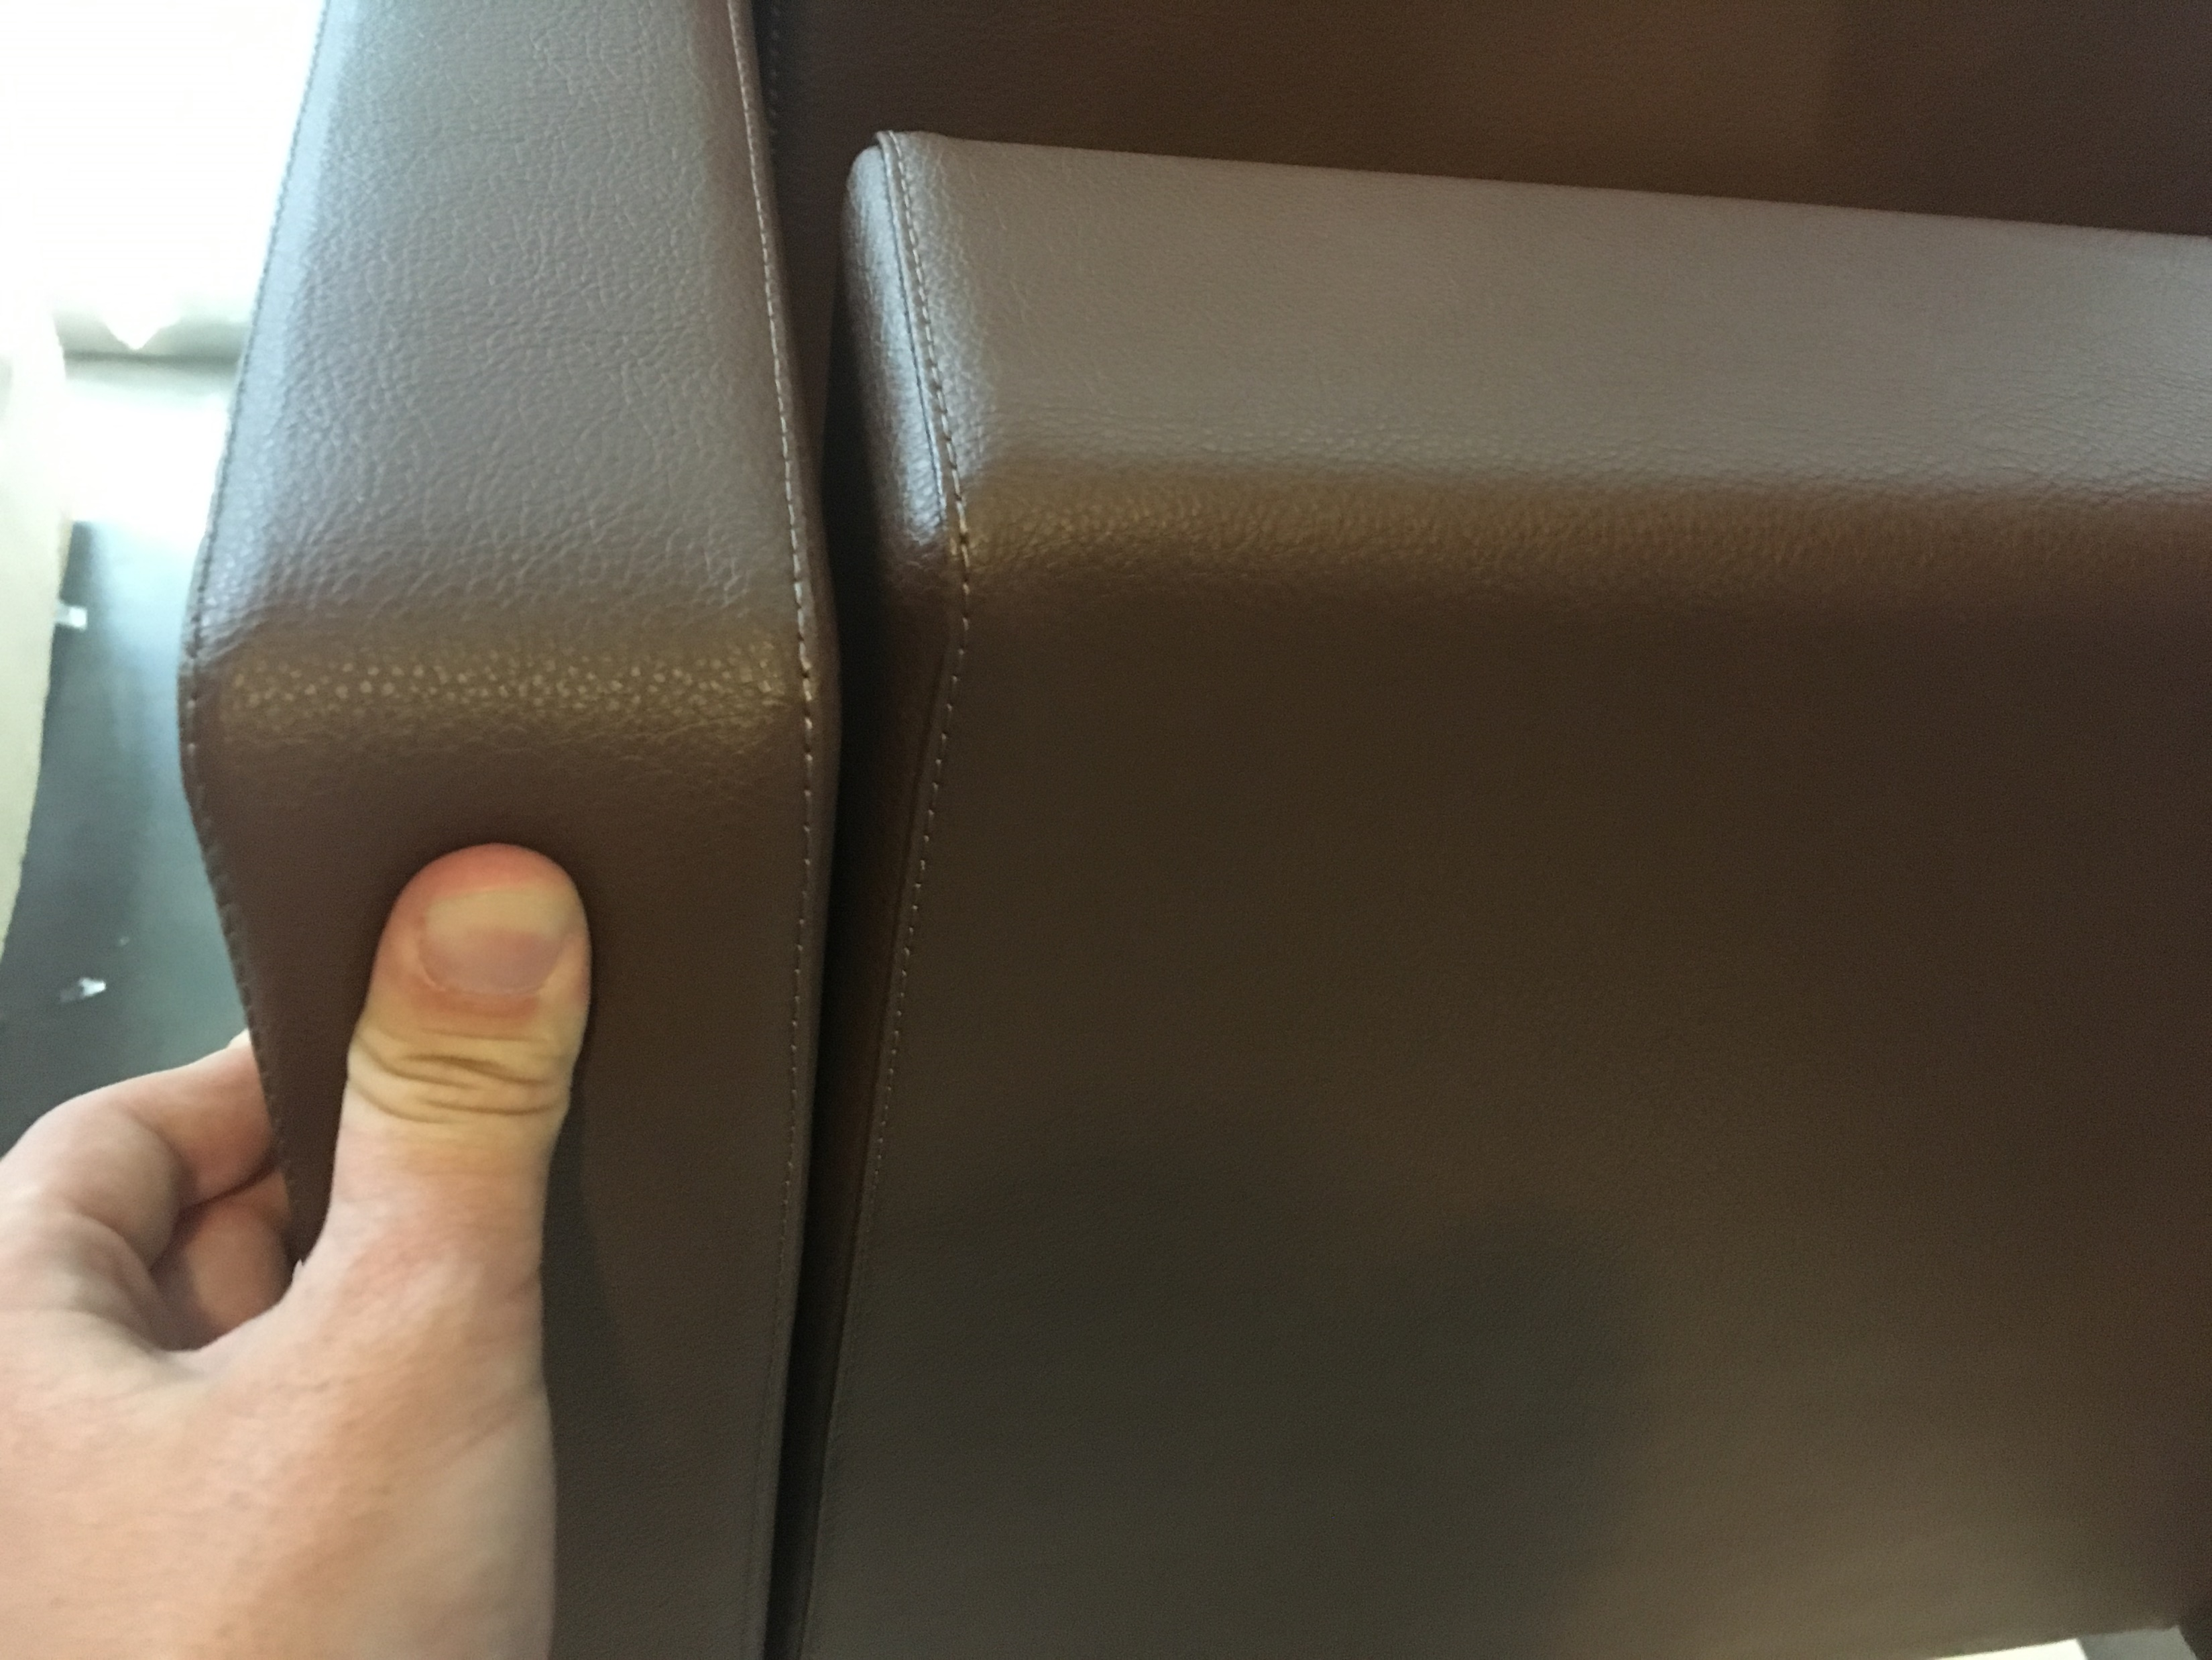
Signage (row and seat numbers)
ORIGINAL TCW DRAWING
Technical QUESTION
(1)
Signage:
please see the images on the right. It cannot be done under the seat because the foam does not have the material density to screw up the signage on it (1).
The solution be to insert it at the lateral frontly (2), please confirm.
(2)

Slide 10
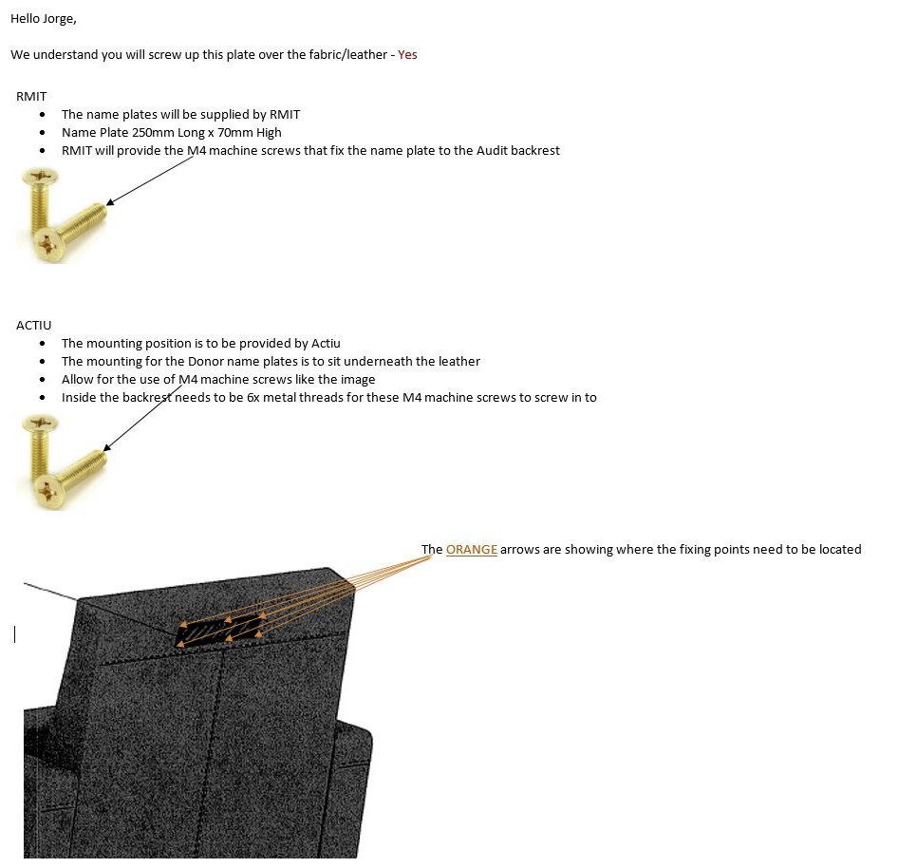
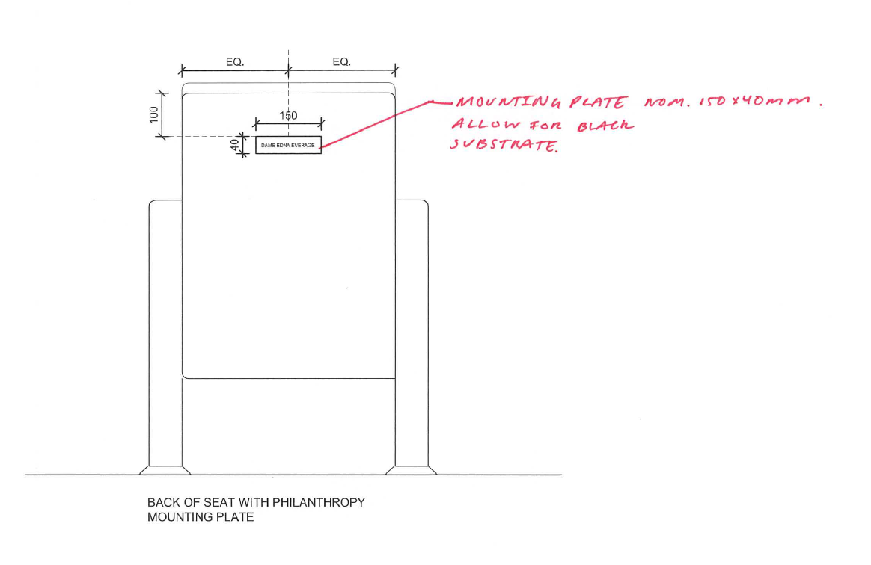
Donor Plate Specifications
Just for types 3-A and 3-B
1:Measures
Original Measures: 250x70mm
Measures Updates: 150x40mm
PLEASE CONFIRM

Slide 11
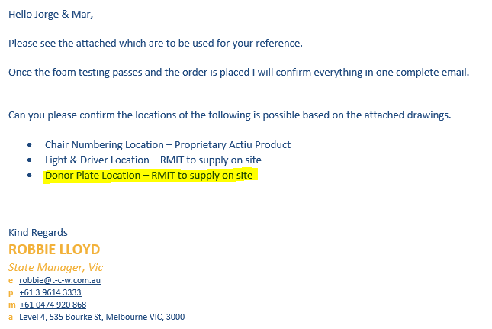
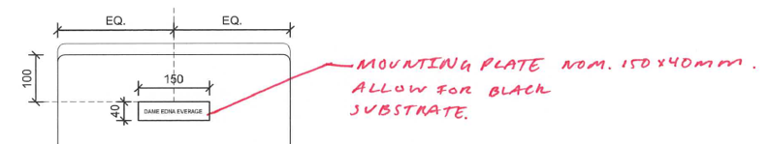
Donor Plate Specifications
Just for types 3-A and 3-B
2:Donor Plates Manufacturing
1: Means that we do not have to manufacture the donor plates in actiu?
2: We just get ready the backrest for the client to screw them at the backrest?
3: What means allow for black substrate?
PLEASE CONFIRM

